Slide 1




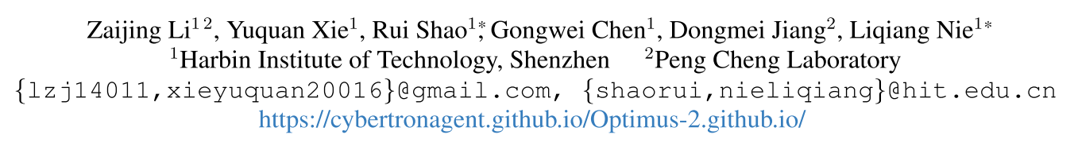





ATAI
Advanced Techniqueof Artificial Intelligence
ATAI
ChongqingUniversity _{AdvancedTechniqueof}
of Technology Artificial Intelligence
Chongqing University of
Technology
Chongqing University ^{ATAI}
_{of Technology} Advanced Techniqueof
Artificial Intelligence
Chongqing University of Technology
Chongqing University of Technology
Optimus-2: Multimodal Minecraft Agent with Goal-Observation-Action Conditioned Policy
Code:None.
—— CVPR 2025
Reported by Tingting Zhang
1

Slide 2

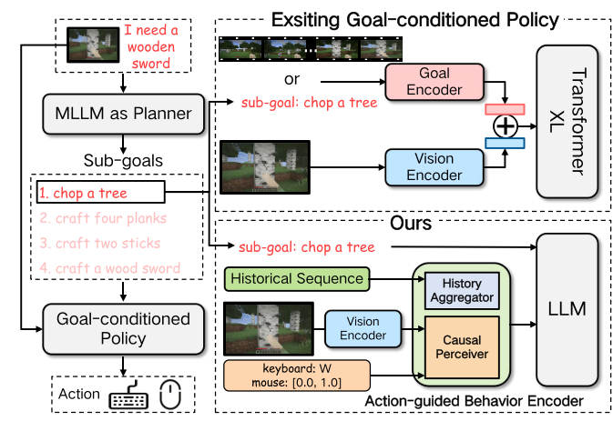
ATAI
AdvancedTechniqueof
Artificial Intelligence
ATAI
ChongqingUniversity _{AdvancedTechniqueof}
of Technology Artificial Intelligence
ChongqingUniversity of Technology
Motivation
1. Existing policies neglect the modeling of the relationship between observations and actions.
2. Existing policies struggle to model the relationship between open-ended sub-goals and observation-action sequences.

Slide 3

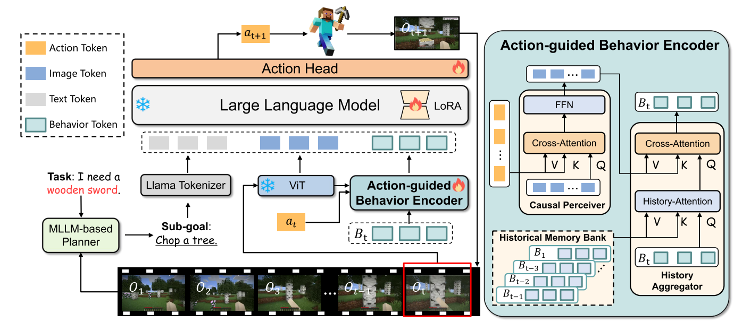
ChongqingUniversity of Technology
ATAI
AdvancedTechniqueof
Artificial Intelligence
ATAI
ChongqingUniversity _{AdvancedTechniqueof}
of Technology Artificial Intelligence
Overview

Slide 4

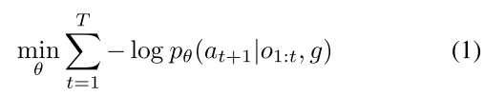
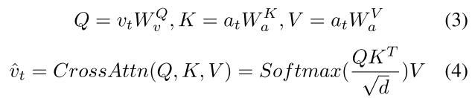
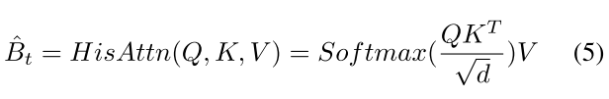
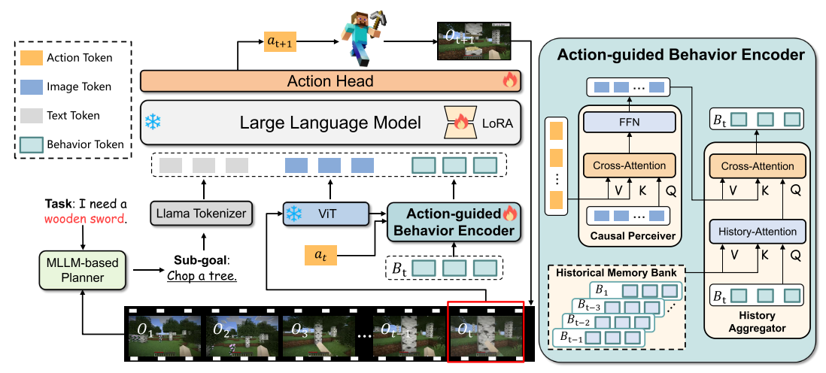
ChongqingUniversity of Technology
ATAI
AdvancedTechniqueof
Artificial Intelligence
ATAI
ChongqingUniversity _{AdvancedTechniqueof}
of Technology Artificial Intelligence
Method

Slide 5
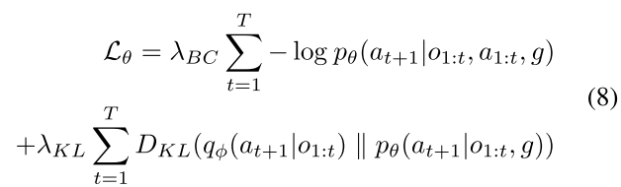
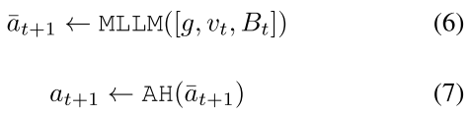
ChongqingUniversity of Technology
ATAI
AdvancedTechniqueof
Artificial Intelligence
ATAI
ChongqingUniversity _{AdvancedTechniqueof}
of Technology Artificial Intelligence
Method

Slide 6

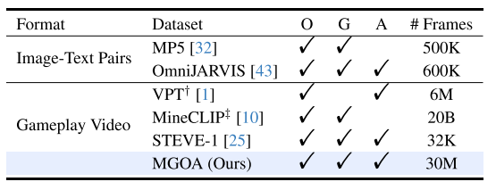
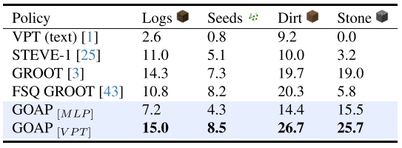
ATAI
AdvancedTechniqueof
Artificial Intelligence
ATAI
ChongqingUniversity _{AdvancedTechniqueof}
of Technology Artificial Intelligence
ChongqingUniversity of Technology
Experiments

Slide 7
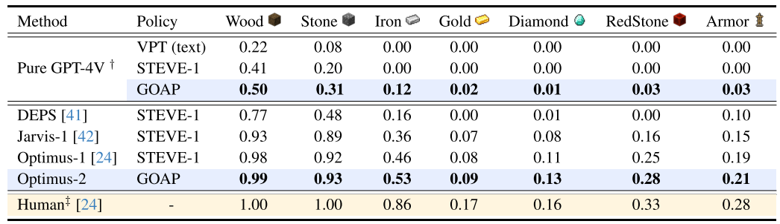
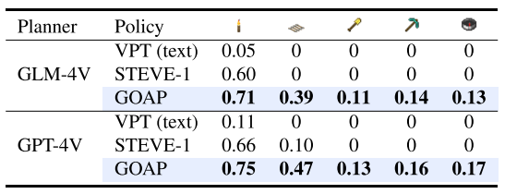
ATAI
AdvancedTechniqueof
Artificial Intelligence
ATAI
ChongqingUniversity _{AdvancedTechniqueof}
of Technology Artificial Intelligence
ChongqingUniversity of Technology
Experiments

Slide 8
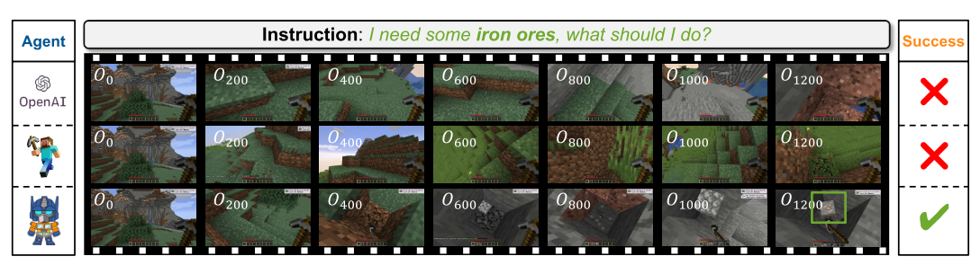
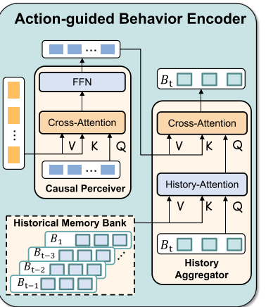
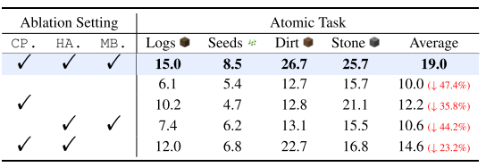
ATAI
AdvancedTechniqueof
Artificial Intelligence
ATAI
ChongqingUniversity _{AdvancedTechniqueof}
of Technology Artificial Intelligence
ChongqingUniversity of Technology
Experiments

Slide 9
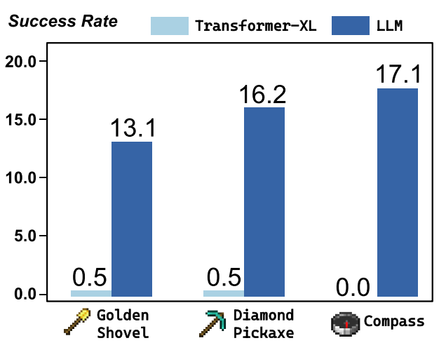
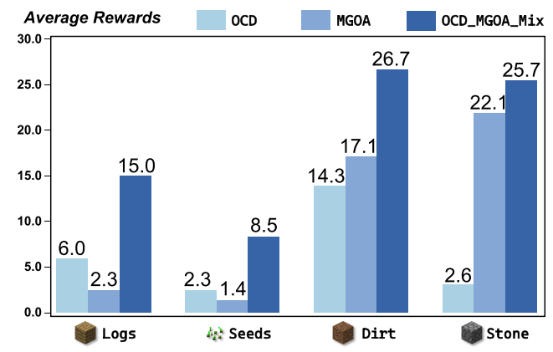
ATAI
AdvancedTechniqueof
Artificial Intelligence
ATAI
ChongqingUniversity _{AdvancedTechniqueof}
of Technology Artificial Intelligence
ChongqingUniversity of Technology
Experiments

Slide 10
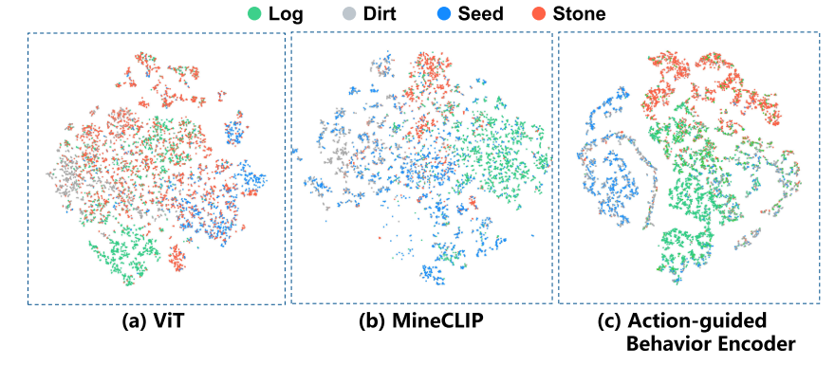
ATAI
AdvancedTechniqueof
Artificial Intelligence
ATAI
ChongqingUniversity _{AdvancedTechniqueof}
of Technology Artificial Intelligence
ChongqingUniversity of Technology
Experiments

Slide 11


ChongqingUniversity of Technology
ATAI
AdvancedTechniqueof
Artificial Intelligence
ATAI
ChongqingUniversity _{AdvancedTechniqueof}
of Technology Artificial Intelligence
Thanks!

